Slide 1

Making Connections
Effective Communication Strategies
for School Board Members
This information is provided for educational purposes only to facilitate a general understanding of the law or other regulatory matter. This information is neither an exhaustive treatment on the subject nor is this intended to substitute for the advice of an attorney or other professional advisor. Consult with your attorney or professional advisor to apply these principles to specific fact situations.
Notes:
Today’s focus is about making connections—between you as board members, administrators, staff, parents, and the broader community.
In smaller districts, connections are more personal—your visibility and communication style directly shape perceptions.
Let's explore how we can use communication not just as a tool, but as a relationship builder.

Slide 2
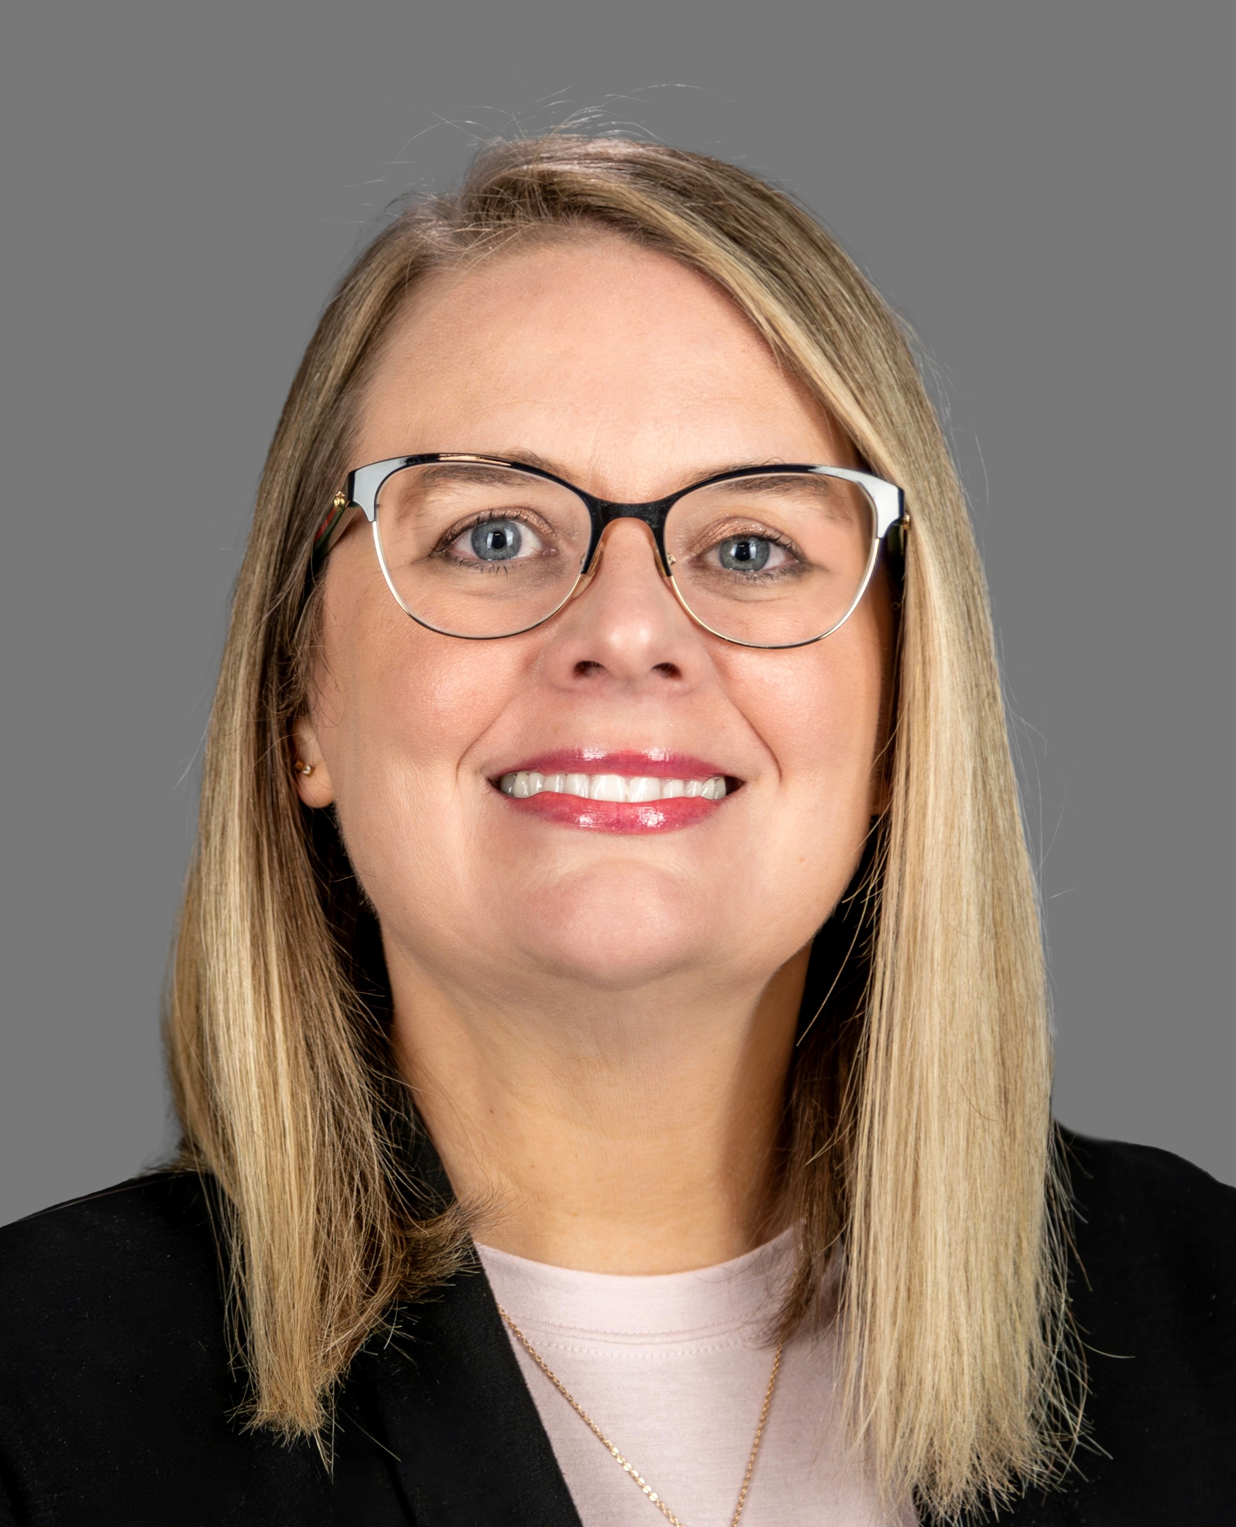

Who We Are
Sara Butler
Department Director, Communications
Brianna Garcia
Department Director, Communications
Notes:
Each do our own intros

Slide 3

Key Objectives
Develop strategies for transparent and proactive communications
Serve as a district ambassador
Learn best practices for using social media to connect with stakeholders
1
2
3
Notes:
Sara will do this slide
Today, we have three objectives, which involve strategies to help you become a more effective leader through transparent and proactive communication.
Why is that important? It promotes a two-way flow of information with your community, and most importantly – it builds trust.
How to serve as ambassadors for your district. We're not expecting you to become PR experts in the time we have with you today – it’s more about representing your district effectively.
Part of being an ambassador is crafting your approach to communications based on your audience. Parent or media? Different approaches.
And finally, we want to give you some strategies around how to best use social media to connect.

Slide 4

Poll: What's the communications situation ​in your district?
No communications department
One-person communications shop
Communications team
Notes:
Brianna will do this slide
*Do we have any board presidents in the room?
-why its important to have a communications strategy. The public, media, parents all get the same information of transparency.
--Let’s see a show of hands of where your district is with communications. How many have no communications department, one-person team, full team?
Whether you have a communications department or not in your district, your most valuable relationship will be with your superintendent

Slide 5
Key Communications Strategies
1
2
Set the expectations
Watch for timeliness and tone
Ask targeted questions
Carefully navigate “in
the moment” situations
3
4
Notes:
Sara handles this section through Crisis section
We’re about to break down four communication practices that can make your job easier and clear a path toward clearer communication.
These strategies help reinforce trust and keep conversations constructive—even during tough times.
These strategies are: Set the expectations, Watch for timeliness and tone, Ask targeted questions, and Carefully navigate “in the moment” situations

Slide 6
Set the Expectations
1
FYI process
Practice responsive and respectful communications with parents, staff and students
We respond even when we can’t be perfect
Request talking points as appropriate to help ensure a consistent message
Notes:
The first strategy is “Set the Expectations”
Setting communication norms can reduce confusion. Consistency builds trust. Think about how often parents get mixed messages—setting the tone and process makes sure there’s unity in what is shared.
FYI Process – You can work with your supe on how information will flow from administration to the board, and what information is being communicated to parents. (expand on this) Does anyone currently have such a process in place? Cc?
Also – Establish the protocol with your board as to who will be responding for the board. Generally, the board president serves as the board’s spokesperson. Do we have any board presidents in attendance? How does it work in your districts? If unsure, check your policy.
Practice and set expectations around responsive & respectful communication to all stakeholders. Set that standard with your superintendent to ensure that is a priority.
Third, perfection is not the goal. What happens when we don’t know *all* of the information? We’re responsive with what information we can relay, and we provide reassurance that communication is open and ongoing.
Another way we can be unified in our messaging is to request talking points from your superintendent and/or the statement that has been provided—so that whomever is speaking for the board can be on message.

Slide 7
Watch for Timeliness and Tone
2
Are parents getting the information they need when they need it?
Are you being kept informed of important issues, so you can answer parent/community questions?
Empathetic voice
We’re all in this together
Notes:
The second strategy is “Watch for Timeliness and Tone”
So, timeliness can make or break trust. And in the absence of information or communication, rumors can run wild. We don’t always have all the answers, but how and when we respond matters.
Are parents receiving information in a timely manner?
Are you as board members being kept up to date on important developments?
3. & 4. Are you practicing your communications with an empathetic voice -- that can show parents and the community that we’re in this together.

Slide 8

Look at the following example of a parent communique. What sentences or phrases help convey the ideas discussed around timeliness/tone and conveying that we’re all in this together?
Discussion
Time
5 minutes
Notes:
And now we’re going to examine how we put timeliness and tone into practice in our communications ….
Get together in groups (tables?)

Slide 9
Parents,
I want to make you aware that a first grader brought a black, plastic toy gun to school today in their backpack, took it out while in class and showed it to another student. It was immediately confiscated by the teacher, who reported the incident to me. Although it was a toy and did not cause harm to anyone, we take these matters very seriously and appropriate disciplinary action is being taken.
Please take this opportunity to emphasize with your student the seriousness of bringing inappropriate and illegal items to school and encourage them to immediately report anything that might be a danger or seem threatening.
Thank you for all you do for your children and for our school. Let’s continue to work together to keep our students safe.
If you have questions, please call the school at 123-456-7890.
Sincerely,
John Doe
Principal
Example 1

Slide 10
Parents,
I want to make you aware that a first grader brought a black, plastic toy gun to school today in their backpack, took it out while in class and showed it to another student. It was immediately confiscated by the teacher, who reported the incident to me. Although it was a toy and did not cause harm to anyone, we take these matters very seriously and appropriate disciplinary action is being taken.
Please take this opportunity to emphasize with your student the seriousness of bringing inappropriate and illegal items to school and encourage them to immediately report anything that might be a danger or seem threatening.
Thank you for all you do for your children and for our school. Let’s continue to work together to keep our students safe.
If you have questions, please call the school at 123-456-7890.
Sincerely,
John Doe
Principal
Example 1

Slide 11
Ask Targeted Questions
3
What do we know?
How do we know it?
What can we share?
Are additional/different resources needed?
Next time, how can we do better?
Notes:
And to quickly wrap up, the third strategy is “Ask Targeted Questions”
Before responding publicly, strategize with your superintendent. Pause and ask these questions:
What do we know?
How do we know it? Are the sources of information verified?
What can we share? Are there privacy concerns to consider?
And, especially after the fact (perhaps during a debrief):
Are additional/different resources needed?
Next time, how can we do better?
These questions keep communication intentional rather than reactive.

Slide 12
Carefully Navigate
‘In the Moment’ Situations
4
Listen first and display empathy
Follow chain of command as you navigate
Relay concerns to administrators
Work to ensure appropriate person follows up
Notes:
The fourth strategy is “Carefully Navigate ‘In the Moment’ Situations
Very important to LISTEN FIRST – and display empathy and focus on getting constituents the assistance they need
Follow chain of command as you navigate (your supe is your point of contact)
Relay concerns to administrators – You can’t solve every problem – nor are you expected to; Supe is the conduit for your concerns; So steer questions to the supe to be routed to the appropriate area; Work to ensure appropriate person follows up
Remember: You may be the first point of contact for community concerns. Listen carefully and bring concerns to the superintendent, BUT you shouldn’t feel pressed to solve or explain complex issues on the spot. And this isn’t the time to try to sway opinion but to express that their input is valuable.

Slide 13
A parent is unhappy with a recent curriculum change your board approved. This parent approaches you at the grocery store.
How do you respond?
Discussion
Time
5 minutes
Notes:
So, here is an “in the moment scenario” that may be familiar ground for you. (read prompt)
Get into your same groups and for the next 5 minutes, discuss how you would handle this situation
Key takeaways: Rehearse boundary-setting with empathy. Acknowledge the concern, explain the process, and direct them to the right place. Remember that you represent the board—not just yourself—so consistency and your approach as a board is key.

Slide 14
Communications in a Crisis
Plan,
prepare, practice
Be timely,
not perfect
Stand on
your message
Do a debrief
1
2
3
4
Notes:
So let’s move on to crisis communications and some strategies to be mindful of. Whether you are dealing with a natural disaster, a pandemic, or the death of a student, (god forbid), a crisis and how you respond to that crisis can define public trust.
Let’s walk through the four parts of a solid crisis communications strategy, which are:
The 3 P’s: Plan, prepare & practice
Be timely, not perfect
Stand on your message
Do a debrief
These four points are the things that matter when something goes wrong and emotions run high.

Slide 15
Plan, Prepare, Practice
1
Plan ahead: What will the flow of information look like in a crisis?
Practice and know your role
Be proactive when a crisis looms
Pay attention to other districts and how they navigate a crisis
Notes:
#1 Plan, Prepare and Practice
Hope is not a strategy.
Plan ahead. The best time to prepare for a crisis is before it happens. Smaller districts might not have a large communications team or even a designated communications staff member—so in those instances, it’s even more reason to map out roles and plans in advance.
Practice and know your role -- Support administration; Deliver consistent messaging w/fellow board members (ex: ongoing invest. & no further info at this time). Stick with official message), Guide community to the right person and/or official district channels of information; you can always practice scenarios at board retreats or superintendent briefings.
Be proactive. Is there a bad weather event headed your way? Talk about how the board will help bolster communications efforts.
Take notice of how other districts and boards navigate communications when a crisis strikes. You can learn a lot about what’s effective and ineffective.

Slide 16
Be Timely, Not Perfect
2
Be responsive, even if you don’t have all the answers
Correct misinformation
Acknowledge concerns in the moment
Be clear: Ambiguity breeds discontent
Notes:
The second strategy is “Be Timely, Not Perfect”
We’ve touched on this strategy already, and it’s never more important than during a crisis.
Be responsive – even if you don’t have all the answers: Don’t wait to craft a perfect message. A short, timely statement that shows concern is better than silence. Small communities rely on fast word-of-mouth—make sure it’s your message, not the rumor mill.
Correct misinformation – if you see or hear misinformation being shared, don’t be afraid to correct the information and point community members to reliable sources of information, such as district social media channels or their website.
Acknowledge concerns in the moment – this goes back to timeliness and tone
Be clear – check that the message isn’t ambiguous or confusing

Slide 17

Teacher accused of giving melatonin gummies to second-graders
Notes:
At one of my districts, we had an instance of a teacher administering melatonin gummies to elementary students. This is something that’s happened elsewhere in the state and even across the nation. In this case, a student reported to her parent that this had happened in her classroom. The parent went straight to the media, the media called us, and thus began the communications and investigative process. And yes, this later hit the national news media.
So, we knew the first step was to notify our parents at that campus first—as well as our board. Our board president was in contact constantly with our supe, and along with that 1:1 communication, on all communications we sent out to parents, staff and media we also cc’d our board members.
It was very early in the investigation, so a short response was shared with the media:

Slide 18
Immediate statement in response to media (after notifying parents and the board)
“Per the district's standard policy and procedure, the teacher is currently on administrative leave at this time as part of the investigative process.”
Notes:
Immediate statement (responding to media request): "Per the district's standard policy and procedure, the teacher is currently on administrative leave at this time as part of the investigative process.“

Slide 19
Updated statement issued later that afternoon
“We are aware of allegations that a staff member allegedly administered melatonin gummies to several students on Thursday. The staff member has been removed from the classroom and placed on administrative leave, pending ongoing investigation from campus administration. The district takes every allegation of educator misconduct seriously and will take all measures necessary to ensure that our students are educated in a safe and nurturing environment.”
Notes:
Later that same evening, once more information was available, we issued a more in-depth statement, as shown. The key here really was keeping our board on top of what developments were taking place and having them prepped and ready to defer to the board president if they received any media calls. Second, we made an effort to be timely (not perfect) with our information. That first response was pretty bare bones. But it showed that we were aware and engaged.
Updated statement (same evening): “We are aware of allegations that a staff member allegedly administered melatonin gummies to several students on Thursday. The staff member has been removed from the classroom and placed on administrative leave, pending ongoing investigation from campus administration. The district takes every allegation of educator misconduct seriously and will take all measures necessary to ensure that our students are educated in a safe and nurturing environment.“

Slide 20
Stand on Your Message
3
Get on the same page with messaging
If you have a statement or talkers, stick to them
Your president is the spokesperson for the board
Get the facts, stick to the facts
Notes:
#3: Stand on Your Message
Even if you're getting pressure from all sides, stick to the agreed-upon message—and make sure everyone is on the same page.
Once you issue a statement or receive talking points, don’t go beyond that.
Again, the board president is the spokesperson – so, this is especially key if you get contacted by the media – defer to the president
Get the facts, and stick to the facts

Slide 21
Do a Debrief
4
Set your debrief as soon as possible
Use crises to guide future decision-making
Find the opportunity that exists within a crisis
Pay attention and go over feedback from the community
Notes:
Don’t let a crisis pass without learning from it.
Hold a debrief, review community feedback, and decide how to improve.
Set your debrief ASAP after a crisis, while information is still fresh
Use lessons learned during a crisis to guide future decision-making
Opportunities can arise from crises – maybe it’s a chance to partner with outside agencies
Review feedback from the community and look for ways to gather that feedback from your constituents

Slide 22
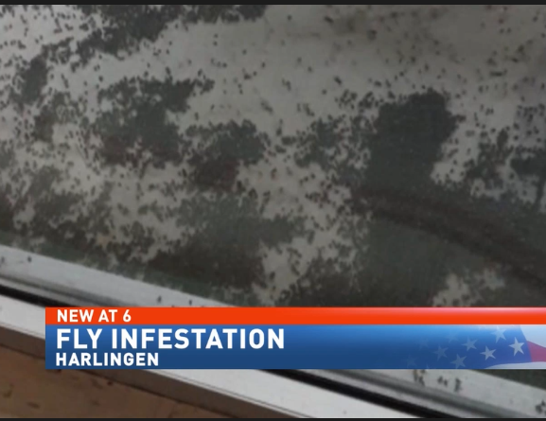
Families, students concerned over fly infestation
Notes:
Let me share a story with you about a very unique crisis situation…I call it the fly infestation of 2018.
Flys invaded nearby homes and our school Cano Freshman Academy, a school for all 9th graders. 9th graders have phones and of course record. First to get out story before we even knew what was going on.
Ended up being that nearby cotton gin was not disposing of materials properly, causing all the flys to swarm in.
We had to set the message straight that the school wasn’t dirty, this was not our fault. School had to shut down for a day for cleaning.
Expect the unexpected. Yes, even flies.
Word of mouth to express the facts and set the record straight.

Slide 23
Consider Yourself a Brand Ambassador
Notes:
Brianna takes over from here until the end

Slide 24
Serving as an Ambassador
1
2
You’re
Always On
Know Your Lane
Promote, Promote, Promote!
First, Do
No Harm
3
4
Notes:
In this category, we are going to cover four main pointers. We are going to talk about how You are Always On, Know Your Lane, How to best Promote Your District, and How to do No Harm.
Feel free to raise your hand because I’d love to hear about ways you already serve as a brand ambassador to your district and how these items relate to you and your district.

Slide 25
You’re Always On
1
What “speaks”
You represent your district
Facial Expressions
Constituents see you as the district
Speech
Mannerisms
Perceptions about your district are shaped by who you are, what you say, what you do
Events you attend
Social Media
Notes:
As a trustee, you're never "off the clock" when it comes to public perception. Your behavior—intentional or not—represents the district at all times.
Even when you're silent, your face and posture communicate. A frown at a board meeting or eye-rolling during a public comment can send the wrong message, even unintentionally.
Whether you’re speaking at an event or chatting with neighbors, your words can build trust—or damage it. Be positive, informed, and measured in what you say.
The events you attend show what you value. When trustees show up to student performances, athletic events, and teacher recognitions, it demonstrates commitment to the entire school community.
Keep conversations professional and consistent.
You Represent Your District
You Represent More Than Yourself
When community members see you, they don’t just see an individual—they see the school board and, by extension, the entire district.

Slide 26
Know Your Lane
2
Board members don’t make administrative decisions
Board members have specific assignments:
Governance | Approve the Budget
Hire and evaluate the Superintendent | Develop and Approve Policy
Notes:
Start with role clarity and expectations – for everyone
• As trustees, you already know this—but it’s always worth revisiting: you lead at the governance level, not the operations level.
• You are not tasked to be in classrooms setting lesson plans or deciding bus routes—and that’s a good thing. You hire a superintendent and team you trust to handle those responsibilities.
• Your power lies in the big-picture decisions—approving the budget, setting policy, and making sure your students are getting what they need to succeed. You focus on the what and administration focuses on the how.
• "When you stay in your lane, it sends a clear message to the community: my district is united, professional, and focused on students.

Slide 27
Promote, Promote, Promote!
3
Share great news and points of pride
Listen to challenges posed by constituents
Amplify district success stories
Notes:
-You are one of the most visible champions in your district, so the best thing you can do is talk about how great your schools and students are.
-You don’t need a press release or communications department to share a story. Word of mouth is actually one of the most powerful marketing tools, whether that’s an in person conversation or you use social media (which we will talk about in a little bit)
-Being a good promoter doesn’t mean only talking. You have to listen too. When someone shares a problem, you don’t have to solve it on the spot. Just by listening and showing you care helps people feel heard.
Sara Example: 5 Good Things Email

Slide 28
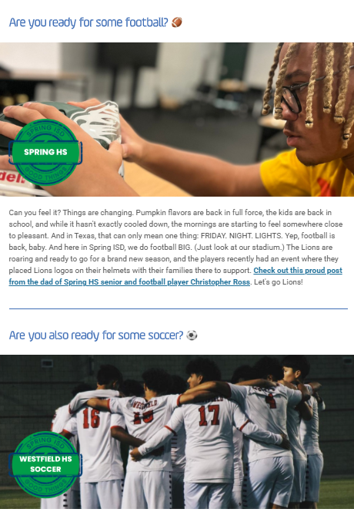


Share
What’s
There!

Slide 29
First, Do No Harm
4
Speaking negatively about your district has damaging effects
Always seek to enrich, never to reduce
Notes:
You already know this, but its worth emphasizing….what you say, especially in public, has a real impact on how people view your schools.
You don’t have to sugarcoat reality, if things are not great at the moment or your district is going through a hard time, but frame things in a way that build hope and trust. You want to create a culture where people believe in their local schools. It’s very important.

Slide 30
Let’s spend some time creating an elevator pitch about what makes your district the best place for students in your community.
Discussion
Time
5 minutes
Notes:
Elevator pitch: Why should I send my kids to ABC District? Come up with at least three reasons in your pitch.

Slide 31
Social Media Strategies for Trustees
Notes:
This section is a great way to reiterate your role as a brand ambassador.

Slide 32
Social Media Strategies
1
Regularly
Engage
Celebrate
Success
Inspire
Support
2
3
Notes:
I want to ask you,what social media platforms are you on?
Social media tends to be an easy and effective way to engage with your community.
You don’t have to post daily, but showing up regularly keeps you visible and relatable. It shows you’re an advocate for students.
Think of posting on social media as storytelling. Whether that is sharing a post from your district page or you developing the social media post yourself. We will show you some examples of trustees using social media in a bit.
Earlier Sara mentioned, people just want to be heard. That works with social media too. And yes, social media isn’t a space of rainbows and butterflies. There may be posts where people complain, but just remember you also don’t have to respond right away there.
(let me find the district contact for you. Find some time to gather your thoughts, have facts straight, may be other people will respond correctly and you don’t have to step in.)
The goal is to build community.
If you are seeing trends on social media, let your superintendent know. They need to address it.

Slide 33
Regularly Engage with Your Followers
1
Build community connections
Remember, you don’t have to respond in the moment
People just want to be heard
Share district stories and updates often
Notes:
I want to ask you,what social media platforms are you on?
Social media tends to be an easy and effective way to engage with your community.
You don’t have to post daily, but showing up regularly keeps you visible and relatable. It shows you’re an advocate for students.
Think of posting on social media as storytelling. Whether that is sharing a post from your district page or you developing the social media post yourself. We will show you some examples of trustees using social media in a bit.
Earlier Sara mentioned, people just want to be heard. That works with social media too. And yes, social media isn’t a space of rainbows and butterflies. There may be posts where people complain, but just remember you also don’t have to respond right away there.
(let me find the district contact for you. Find some time to gather your thoughts, have facts straight, may be other people will respond correctly and you don’t have to step in_)
The goal is to build community.
If you are seeing trends on social media, let your superintendent know. They need to address it.

Slide 34
Celebrate District Successes
2
Build positive school culture
“Why we do what we do” type of stories
Keep the focus on the students
Notes:
Successes are happening every day in your district. Let’s talk about it! That’s a great way to build a positive school culture.
Yes, its easy to get caught up in the challenges. Especially in these times we are going through in public education across our state. But when you share your story and you lead with the good, you create momentum.
You want to highlight student successes, whether its academic, athletic, artistic or stories of personal growth. It will remind you why you do what you do.

Slide 35
Inspire Engagement and Support
3
Reinforce your district’s mission and goals
Followers will become invested
Shows you’re involved
Seek stories beyond your own social channels
Notes:
And don’t forget district milestones—strategic goals met, new initiatives launched, or progress that demonstrates growth.
It’s important that we celebrate these stories publicly, through newsletters, social media, community events, and even local news. When people see the great things happening, they become more invested.
By doing this, we’re not only informing—we’re inspiring engagement and support from parents, partners, and stakeholders. It helps build pride, trust, and momentum."

Slide 36
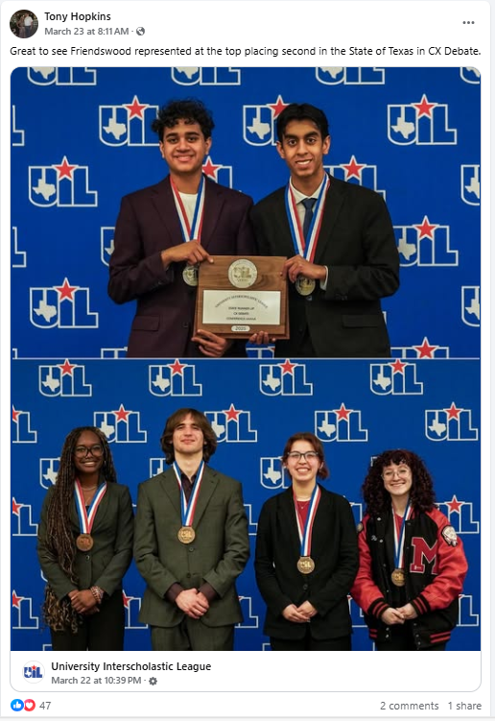
Notes:
TASB President Elect Tony Hopkins is out of Friendswood ISD, near Houston, and he is very active on his social in how he shares stories about his district.
1st: This first example is a post he shared directly from the UIL, University Interscholastic League page. So how I mentioned following pages where your students may be competing. He used this as an opportunity to highlight his students placing second in Debate.

Slide 37
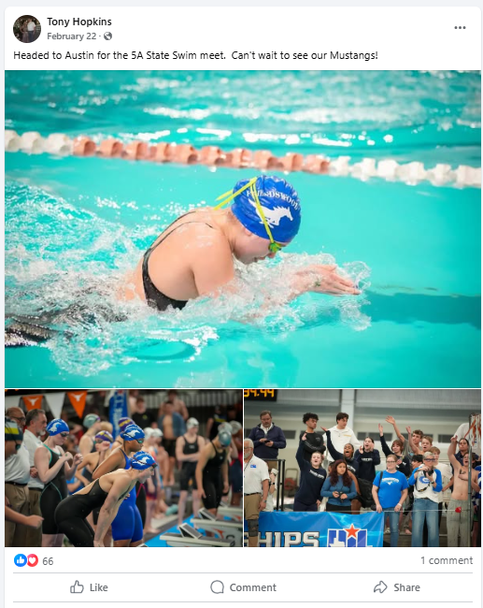
Notes:
2nd: The second Tony example shows how he is talking about traveling to Austin to watch his students complete in the state swim meet. Looks like he grabbed photos from the district and is using this as a great way to showcase his excitement for his kid’s successes.

Slide 38
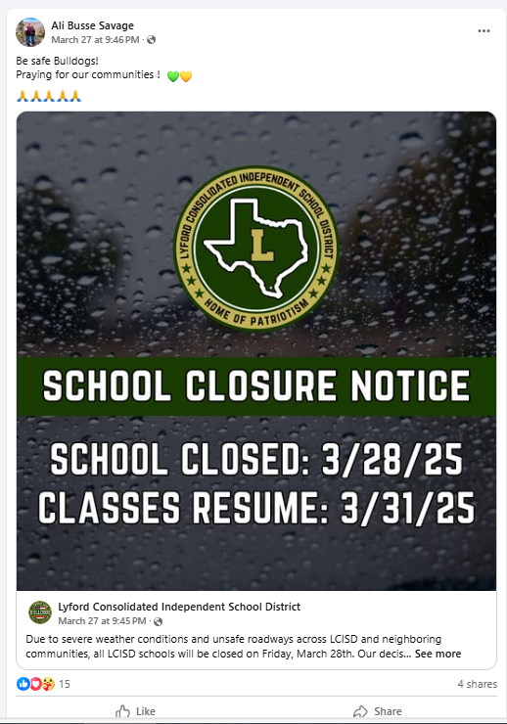
Notes:
3rd: This example comes from Alison Savage down in Lyford ISD, near my hometown. She is our TASB Director representing Region One. In late March, we experienced a devastating flood where we received over 20 inches of water in one night. Members of her community may not follow her school district on social media, but she is using her channel to reiterate the district message and to help spread the word about school being closed on Friday, the day after the storm. Its important to share district crisis updates on social media as well.

Slide 39
A natural disaster just happened in your community. How would you help support communications in your district?
Discussion
Time
5 minutes
Notes:
-superintendent messages, Cc messages
-social media

Slide 40
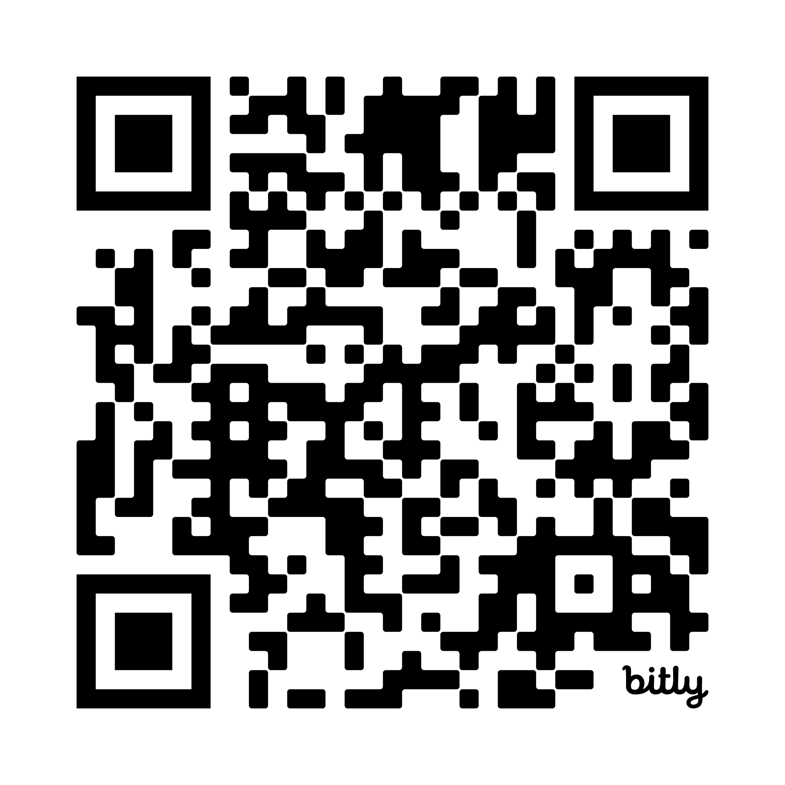
Social Media Guidelines for Trustees
Notes:
This comes from our Legal Services team. These are some good reminders to consider when posting on social media.

Slide 41
Questions?
Sara.Butler@tasb.org
Brianna.Garcia@tasb.org

Slide 42
Making Connections: Effective Communication Strategies for School Board Members
Spring Workshop - Canyon - 2025
5/21/2025
10:30 AM - 11:30 AM
CEC 5828
You must report credit within 24 hours.
Visit tasb.org/mycec and log in using TASB login.

Slide 43
Three Areas of Focus in a Crisis
Amplify accurate information
Counter misinformation
Provide support and direction

Slide 44
What is Your Role in a Crisis?
Support administration
Consistent messaging
Guide to sources of information
Notes:
What is your role in a crisis?
Supporting administration
Consistent messaging with fellow board members (ex: ongoing invest. & no further info at this time. Stick with official message)
Directing to the right person and/or official district channels of information

Slide 45
Sample Email:
Dear Parent:
On Wednesday evening, local law enforcement received notification of a text threat targeting _______ school. The __________ Sheriff’s Department in partnership with Homeland Security worked together to investigate and identify the threat.
After a thorough investigation, law enforcement officials found the threat to be non-critical.
_______ ISD takes all potential threats to student and staff safety seriously. As a precautionary measure, there will be an increased law enforcement presence at the campus for the remainder of this week.
Please continue talking with your children about the seriousness of threats and the importance of reporting suspicious activities, threats, or disturbing information to a trusted adult.
We want to remind our community that if you see something, say something. If you have further questions, please call _____________.
Notes:
Here is a sample email your district may send out to parents regarding a threat to a campus. You could be asked at any moment about this situation by someone in your community. I recommend you stay aware of what information is going out to families. Do not be caught off guard.

Slide 46
Why Your Voice Matters
Your Words Carry Weight
Practice open communication: Regularly share information about decisions, challenges, and successes.
You Influence Community Perception
Others will follow your lead: Staff, Parents, Community
Notes:
Think of yourself as bridge between your community and your district’s schools…
Always seek to enrich, not reduce
As an elected leader, your words and actions influence perception. Being a school trustee is a role where you are never not on display. It’s something to be proud of.
Your presence shows community members the value of your public schools. Others will follow your lead when you speak positively about your schools, whether that be online, at BBQ’s, the grocery store.

Slide 47
Leadership with Boundaries
Focus on Governance
Channel community concerns to your superintendent
Stay Aligned with Fellow Trustees
Even if you didn’t vote in favor
Notes:
You all already know this, but its important to reiterate it through this slide. School trustees set the “what and why” and the district staff handle the “how”
Channel concerns form the community to the superintendent.
Support decisions made be the board as a whole, even if you didn’t vote yes.

Slide 48
Promote Your District with Pride
There is much to celebrate
Enforce District Mission and Goals
Notes:
You are a champion voice in your district.
That’s why we are going to talk about some strategies on social media

Slide 49
10 Crisis Management Tips
Get the facts, stick to the facts
Show empathy as appropriate
Train up on the small stuff
It’s better to be timely than
to be perfect
Parents and staff come first
Never blindside your board
When needed, apologize
Plan, prepare and practice
Best crisis management
is pre-emptive
Stand on your message
Notes:
Update to 5 or delete this slide

Slide 50
Involve the Right People
You Can’t Solve Every Problem
Superintendent is the conduit for board members’ concerns
Steer questions to the superintendent to be answered by the appropriate party
Focus on ensuring constituents get the assistance they need
Don’t complicate the process unnecessarily

Slide 51
The Trustee's Role in Communication
Building Trust Through Transparency
Practice open communication: Regularly share information about decisions, challenges, and successes.
Honesty in Difficult Times
Acknowledge challenges: Be transparent about solutions.
Notes:
Don’t turn community members away. Even as challenging as situations can be. Be reachable. Think of ways constituents can reach out to you. Give them an outlet so that perhaps they don’t come to a board meeting for public comments as their first line of communications.
ASK: How many of you hear from community members outside of the board room?
Transparency works in the way you set expectations with the community. Make sure you refer back to district administration vs. speaking on behalf of yourself.
For example, if budget cuts are necessary, explain the reasons and potential impacts clearly.
**Connecting the work that takes place in the boardroom to what’s happening on campuses and in classrooms

Slide 52
The Trustee's Role in Communication
Stay in the Loop
Board members should ask their superintendent to copy all members of the board on any parent or crisis communications.
Notes:
We encourage Board presidents and superintendents to always remain in communication. *Ask your superintendent to hold group calls about situations. It is important to remain aware of what is happening on campuses so that you are not caught off guard and that you are able to communicate the situation to others if necessary.
*tactical suggestion. If routinely sending out communications, be in the loop.

Slide 53
The Trustee's Role in Communication
Work with District Administration
Keep a log of all questions posed to trustees in any situation.
Notes:
Keep a log of questions from people in your community. Forward the question to the superintendent and asking them and their administration to handle this. Superintendent can support you as a group to have the information you need. You can work with superintendent on the process. Superintendent can say three questions were asked this week, and here is the information that I can provide on the answers.

Slide 54
Community Outreach & Public Engagement
Build relationships with parents, staff, and community leaders
Be present at school district events
Invite feedback through conversations
Notes:
Strong relationships are at the heart of any successful school district. I would consider being intentional about building trust and connection with parents, staff, and community leaders. These are the people who shape and support our schools every day.
We know its not possible to be at every school district event, but if you work together, work together to split up events so everything is covered.
The key is to serve as ambassadors for the district. View yourself as source of trusted information, and don’t get in the weeds on gossip. You help set the tone for the district’s reputation.

Slide 55
Community Outreach & Public Engagement
Address Concerns and Foster Trust
Become known in your community and listen openly
Follow up with transparency
Ex) “I’ve shared your concern with the superintendent and will follow up once I have more information.”
Notes:
To build trust, I encourage you to be visible and engaged in the community. Make an effort to be present at events, respond to outreach, and show that you're approachable. Even if you don’t have an immediate solution, people appreciate being heard and taken seriously.
Always follow up with transparency. If you don’t have all the answers right away, be honest about that—but let them know what steps you're taking to get more information.
For example, you might say:
“I’ve shared your concern with the superintendent and will follow up once I have more information.”
This kind of communication demonstrates integrity, accountability, and a real commitment to partnership with your community.

Slide 56
Community Outreach & Public Engagement
Manage Public Interactions and Comments
Listen first, respond thoughtfully
Stay professional
Notes:
When managing public interactions—whether in meetings, online, or in casual settings—it’s important to listen first. Allow people to fully express their thoughts before you respond. This not only shows respect, but also helps you understand the full scope of their concern. It can be challenging to not get defensive.
Respond thoughtfully and avoid reacting emotionally. Even if a comment feels unfair or aggressive, your role is to remain calm and professional. How you respond can set the tone for the entire conversation.
Always stay professional and remember your role as a school trustee. Stay out of the weeds of daily operations within the district. You're there to represent the community, support district governance, and uphold the mission of the school system—not to engage in debates or take things personally. It's okay to redirect or pause a conversation if it becomes unproductive or hostile.
Your behavior in these moments builds—or erodes—public trust.

Slide 57
Parents/Staff;
I wanted to let you know that today during lunch, a fight broke out in the cafeteria that unfortunately resulted in one student possibly needing stitches. We quickly phoned that student’s parents, who opted to drive their student for follow-up medical.
We are still investigating what caused the fight, but our administrative team was able to break up the altercation and identify all 10 students involved. We take matters like these very seriously, and disciplinary action is being taken.
We are taking steps to prevent any fights like this from occurring again, including minimizing crowding in the cafeteria and putting more adults in place to supervise.
Please emphasize with your child that any kind of physical altercation is a serious violation of our Student Code of Conduct and that all disciplinary measures will be taken. We are also working as a school community to help our students better understand alternative ways to resolve differences.
Should you have questions or concerns, please call the school at 723-456-7890. Thank you for your support.
Sincerely,
Principal Smith
Example 2

Slide 58
Parents/Staff;
I wanted to let you know that today during lunch, a fight broke out in the cafeteria that unfortunately resulted in one student possibly needing stitches. We quickly phoned that student’s parents, who opted to drive their student for follow-up medical.
We are still investigating what caused the fight, but our administrative team was able to break up the altercation and identify all 10 students involved. We take matters like these very seriously, and disciplinary action is being taken.
We are taking steps to prevent any fights like this from occurring again, including minimizing crowding in the cafeteria and putting more adults in place to supervise.
Please emphasize with your child that any kind of physical altercation is a serious violation of our Student Code of Conduct and that all disciplinary measures will be taken. We are also working as a school community to help our students better understand alternative ways to resolve differences.
Should you have questions or concerns, please call the school at 723-456-7890. Thank you for your support.
Sincerely,
Principal Smith
Example 2
Notes:
You’re not going to be writing a comm like this in your role. But you will and should be copied. Could be an opp to discuss timeliness and tone. Use your lens to recommend improvements.

